Slide 1
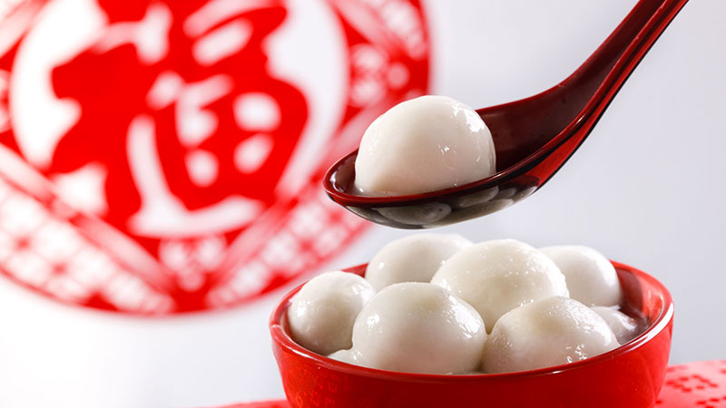
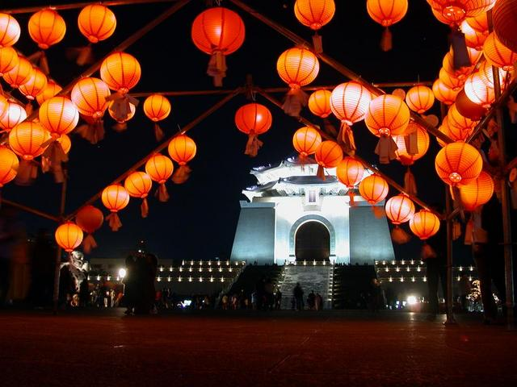
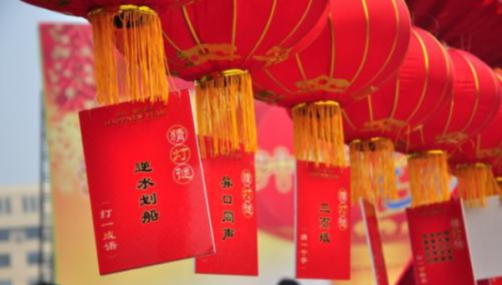
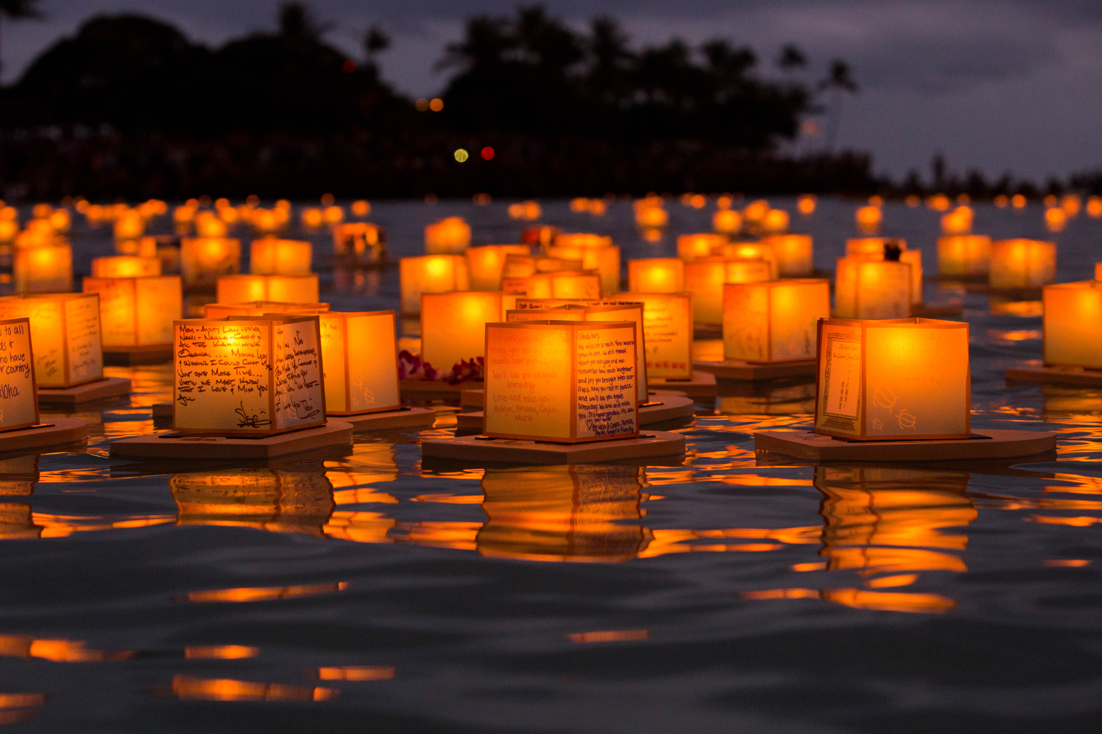
yuán
元
元
xiāo
宵
宵
jié
节
節
Lantern Festival
Notes:
Good afternoon everyone. I’m Chao from the Programming Languages Group. I’m very happy to make this presentation and introduce an important traditional Chinese festival, Lantern Festival, which is just today.
It’s almost mid-night now in China so I’ve got a lot of fresh photos taken just a while ago and I can show you what was really happening in different parts of China.
Lantern festival is called Yuan Xiao Jie in Chinese and here shows both simplified and traditional Chinese characters of it name.

Slide 2
元宵节 · Lantern Festival
15th day of the 1st month in the Chinses lunisolar calendar.
元（yuán）： the name of the first month.
宵（xiāo）：night.
Became a significant festival since Han Dynasty (206 BC ~ 25 AD)
Notes:
In China, Lantern Festival is a special festival. The celebration of the spring festival, or Chinese new year, starts from the 1st day to the 15th day of the 1st month of the Chinese lunisolar calendar. The 15th day, is just the Lantern Festival.
In its Chinese name, Yuan Xiao Jie, Yuan means the first month and Xiao means night. Therefore, Lantern festival has the first night with full moon of the new year and is also understood to be the start of the spring coming back.
Full moon usually means family reunion and you may have heard about another important Chinese traditional festival, mid-autumn festival, which is on the 15th day of the 8th month in the lunisolar calendar, for families to celebrate together.
Lantern festival has been an important festival since Han Dynasty for 2,000 years.

Slide 3
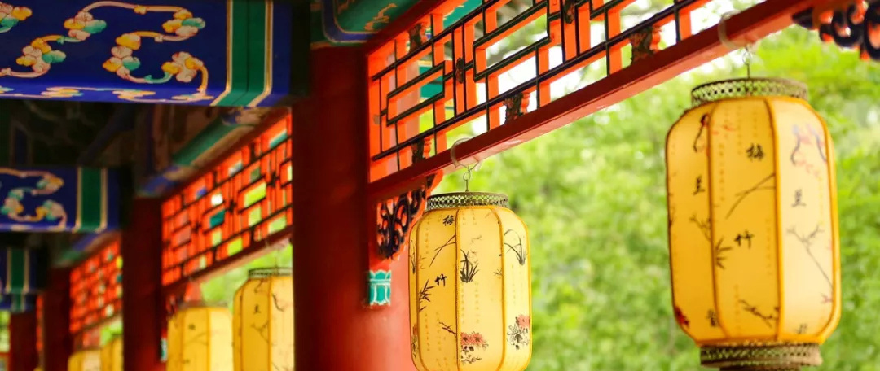
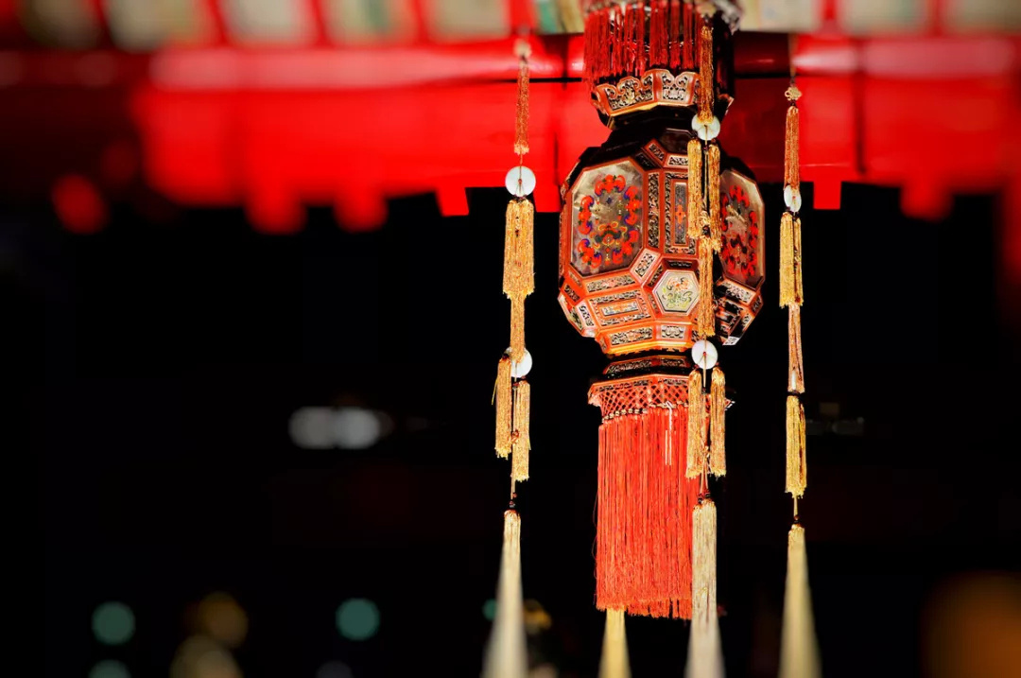
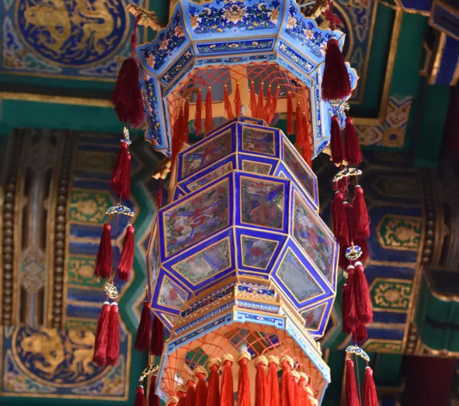
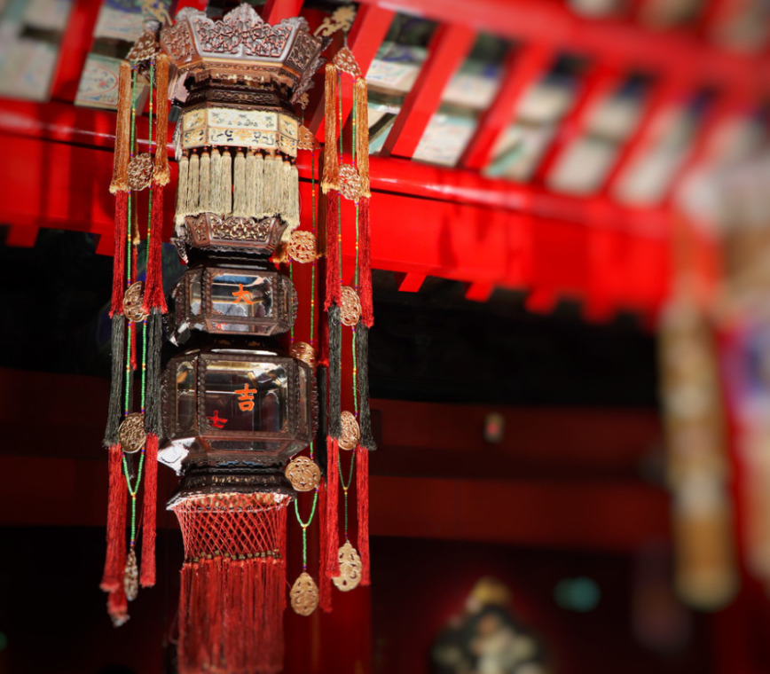
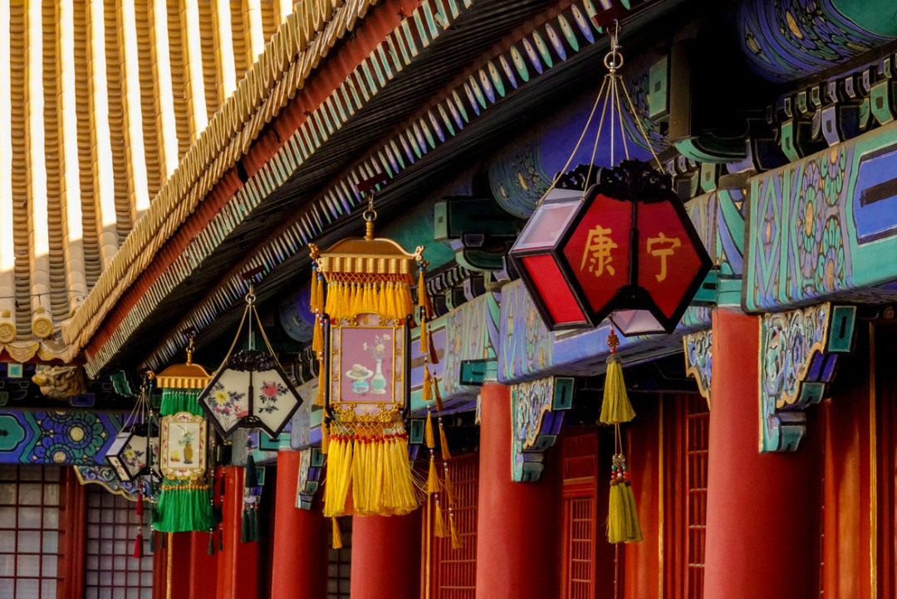
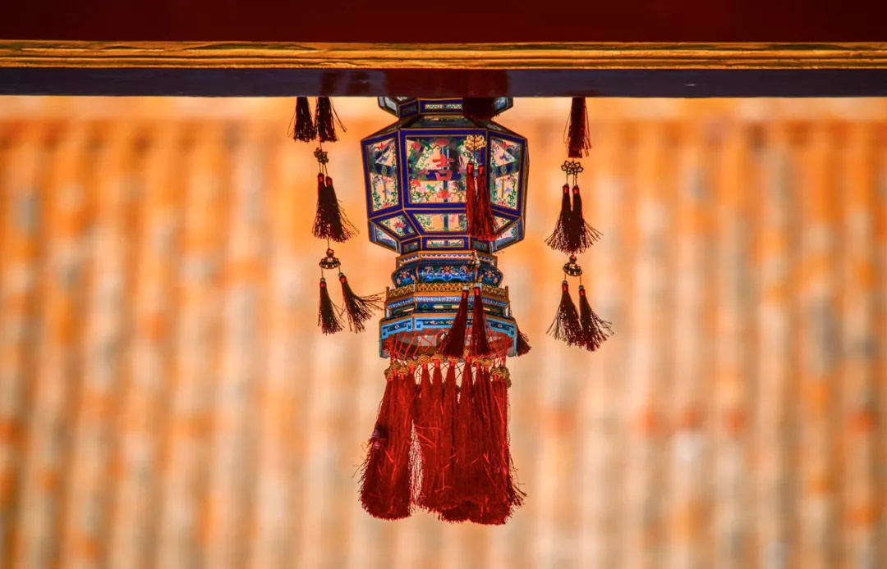
Traditional Lanterns @ Forbidden City
Notes:
At the time, Buddhism was growing in China and the emperor was an advocate of Buddhism.
He noticed a monks’ custom of lighting lanterns in temples on the 15th day of the 1st month and ordered all households, temples and his palace to light lanterns on that evening.
Since then, lighting lanterns became a traditional celebration for this festival and we directly call it Lantern Festival in English.

Slide 4
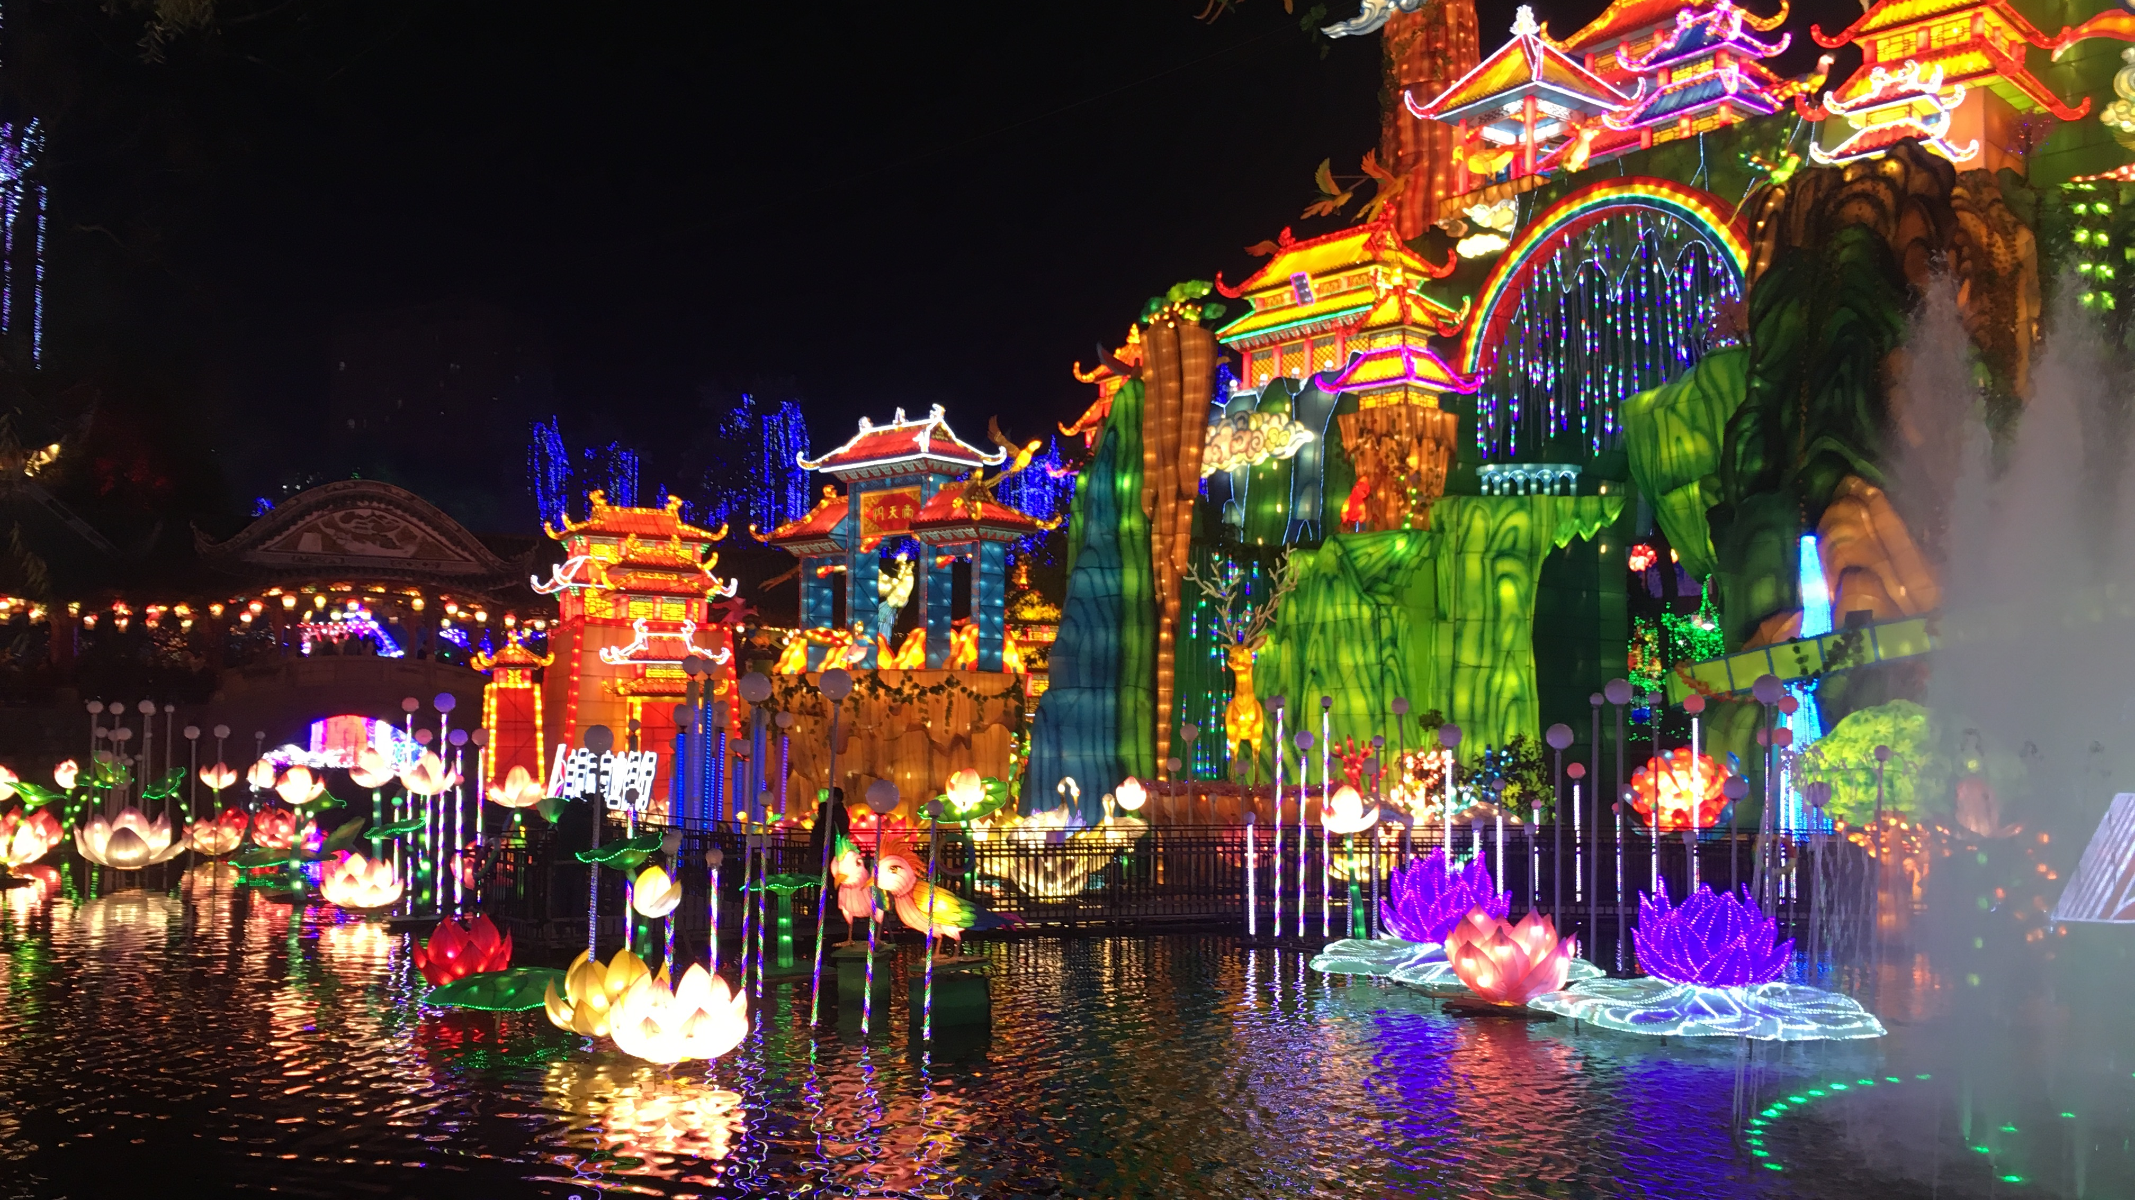
How do we celebrate
Notes:
Now, I’m going to show you how do we celebrate Lantern Festival

Slide 5
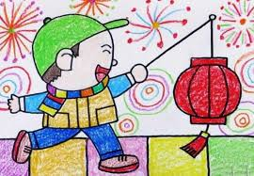
Lighting lanterns and playing together
Notes:
At this night with full moon, for thousands of years, lighting and watching colourful lanterns has been considered as a great event for celebration.

Slide 6
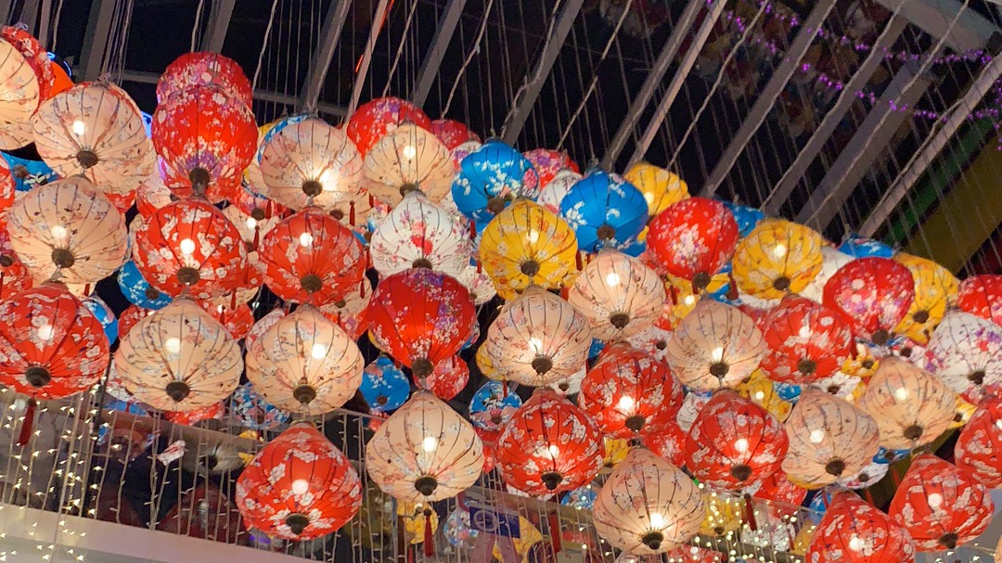
Tonight @ Beijing
Notes:
People go out to enjoy the beauty of the full moon and let off fireworks. In some amusement parks, you may also watch dragon and lion dance.

Slide 7
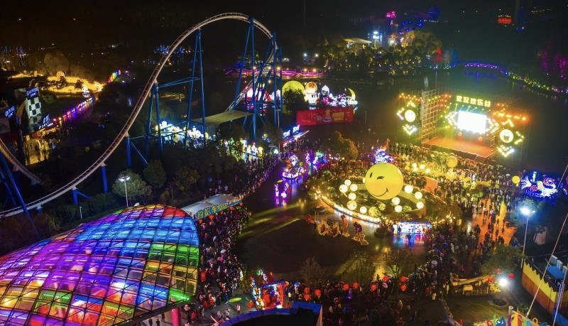
Tonight @ Wuhan
Notes:
In my point of view, Lantern festival is the most hopping and active festival for Chinese people and it is a Chinese version of carnival.

Slide 8
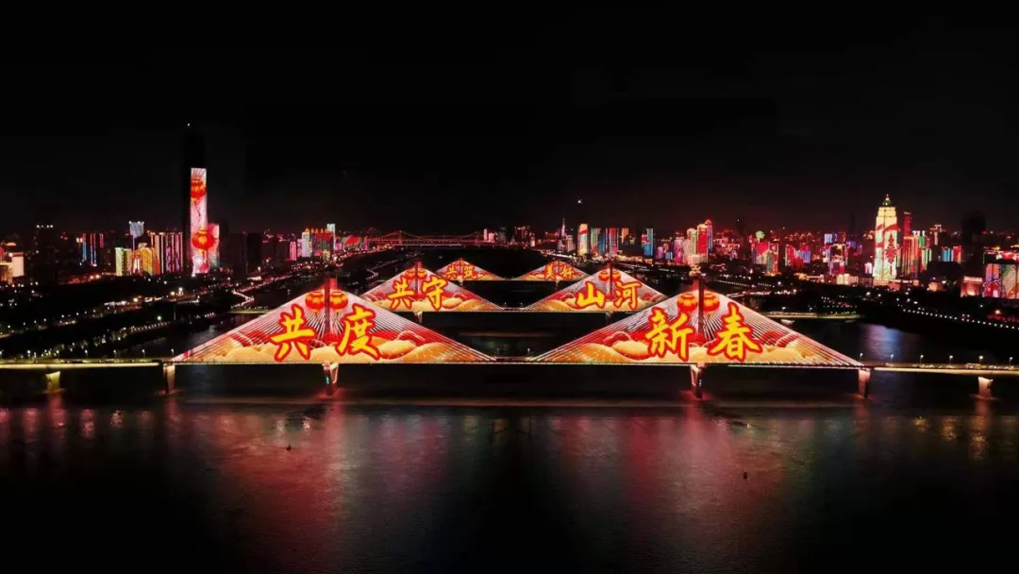
Tonight @ Wuhan

Slide 9
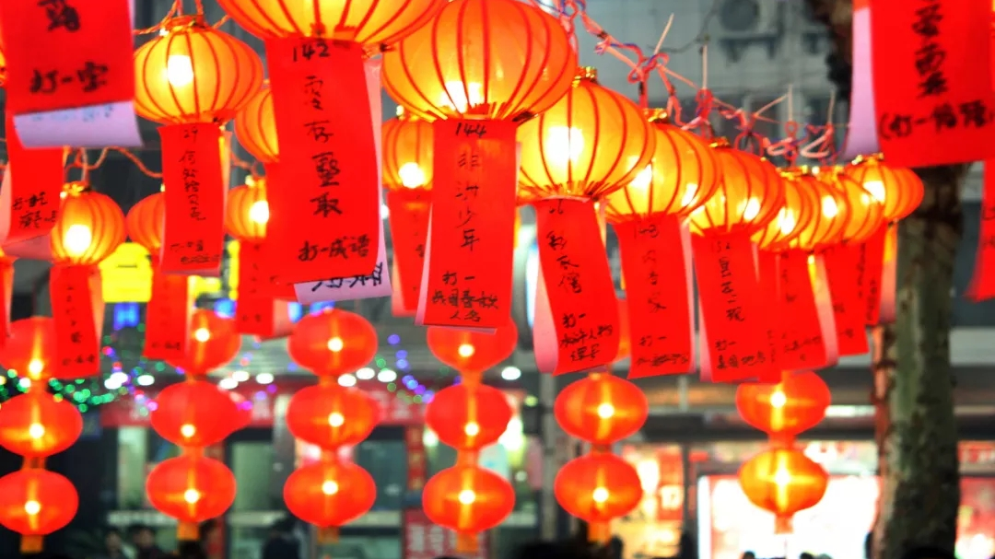
Lantern Riddles
Notes:
Lanterns are hung on the streets and outside houses. You can also find riddles written on red paper attached to lanterns. Riddles can enlighten our mind. There are usually fun and very suitable for festivals.

Slide 10
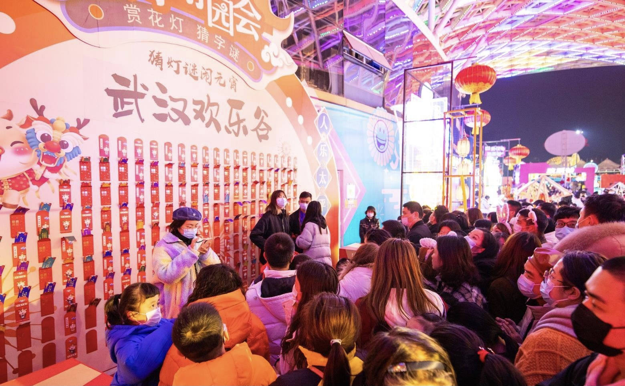
Tonight @ Wuhan
Notes:
In a lot of squares and amusement parts, you can see many people actively participate in guess these riddles. They can get red pockets or other souvenirs when getting the right answer.

Slide 11
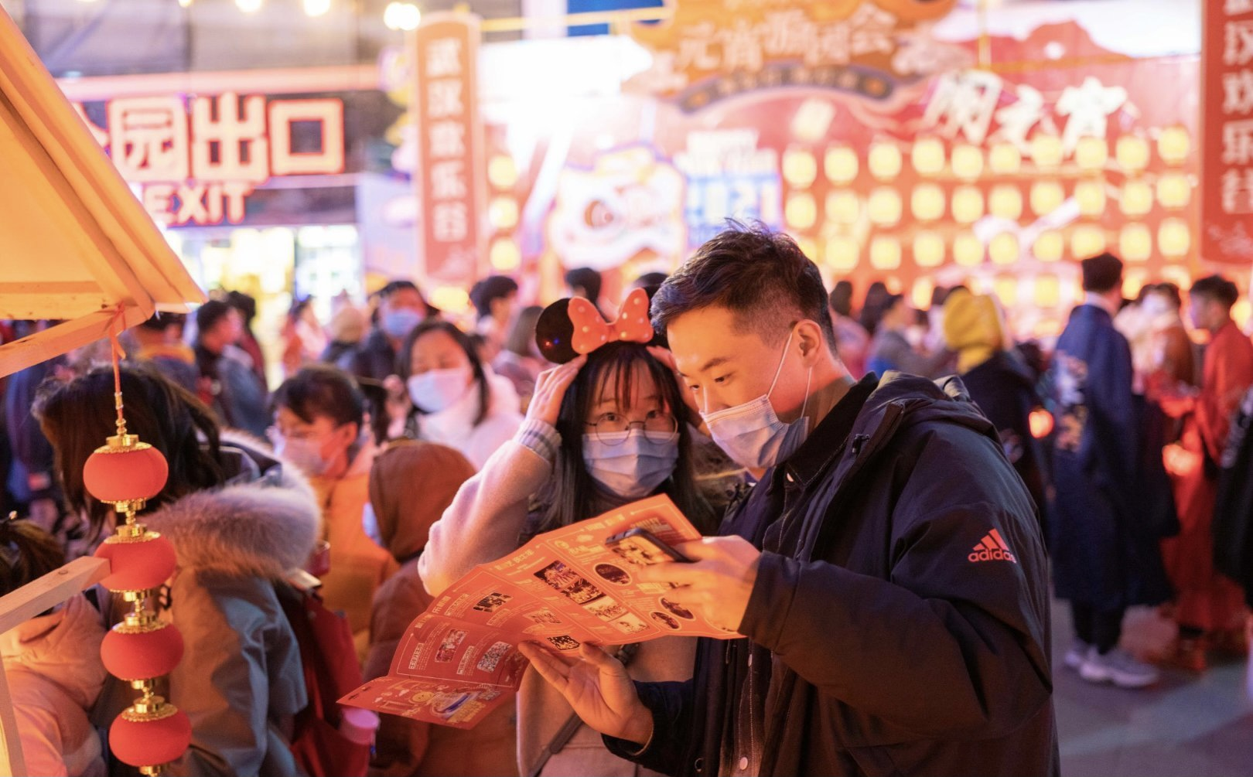
Tonight @ Wuhan
Notes:
Lantern festival is also a good opportunity for young people to meet. This brings Lantern festival a hint of romance.

Slide 12
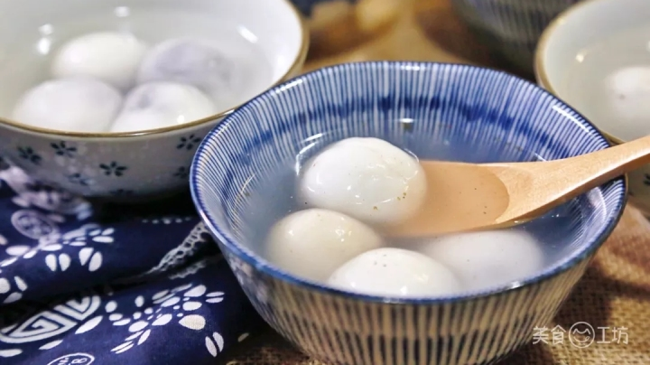
What do we eat?
Notes:
China has a rich culture of foods. Each festival has its symbolic food such as rice dumplings for dragon boat festival and moon cake for mid autumn festival. So what do we eat for Lantern festival then?
After hundreds and thousands years of evolution, eating sweat dumplings has become the most popular tradition in today’s China. In Chinese, the pronunciation and appearance are similar to the word reunion, marking the family reunion and happiness.

Slide 13
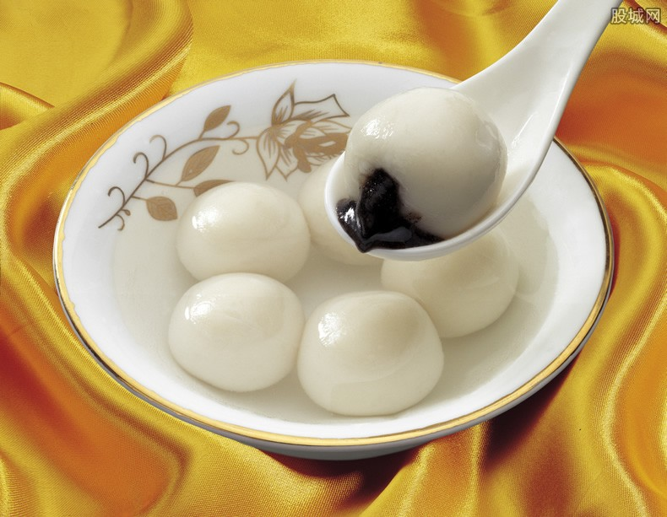
元（yuán） 宵（xiāo）？ 汤（tāng） 圆（yuán）？
Notes:
People have a bowl of 汤圆 or 元宵 and wishes a happy family life for the coming year.
Although 汤圆 and 元宵 have a very similar appearance. They are very different in terms of making them.

Slide 14
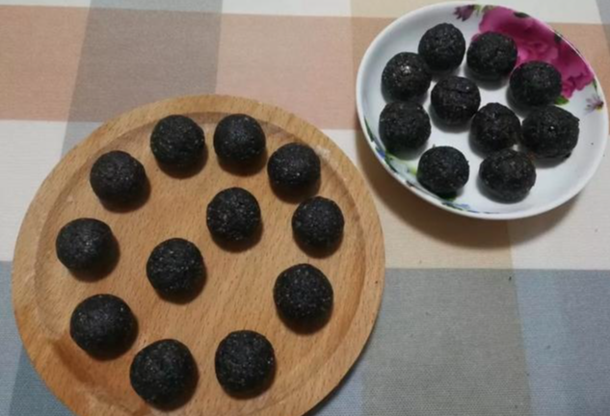
元（yuán） 宵（xiāo）
Notes:
To make Yuan Xiao, Black Sesame is first prepared as the filling

Slide 15
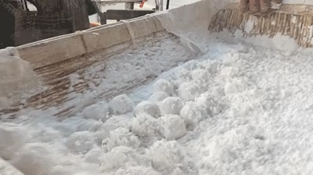
元（yuán） 宵（xiāo）
Notes:
Pieces of black sesame are then put into a container full of glutinous rice flour and the contained is shaked continuously.

Slide 16
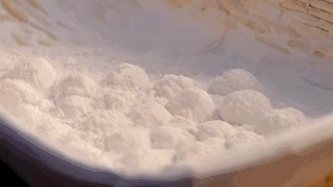
元（yuán） 宵（xiāo）
Notes:
Small rice balls are growing and they can be sunk into water and put into the container and shaken again and again.

Slide 17
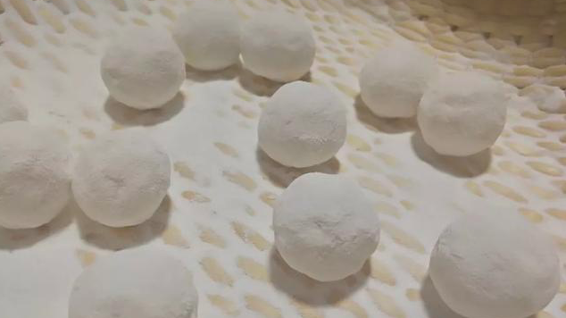
元（yuán） 宵（xiāo）
Notes:
Finally, we get Yuan xiao.

Slide 18
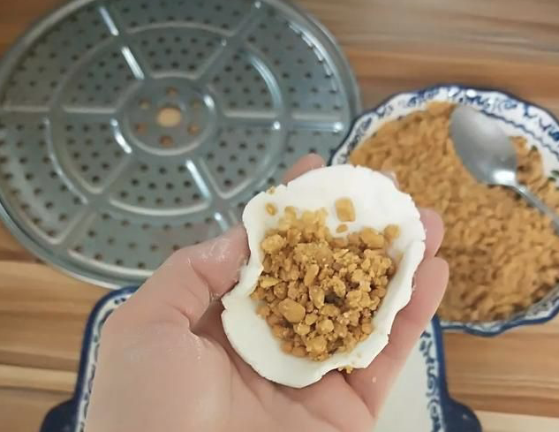
汤（tāng） 圆（yuán）
Notes:
By contrast, Tang Yuan is made in a way like making dumplings.

Slide 19
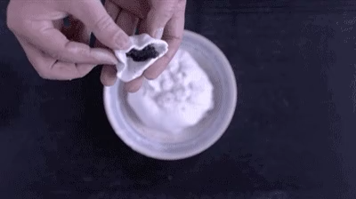
汤（tāng） 圆（yuán）
Notes:
Black sesame or other ingredients are wrapped into glutinous rice flour by hand and twisted into balls.

Slide 20
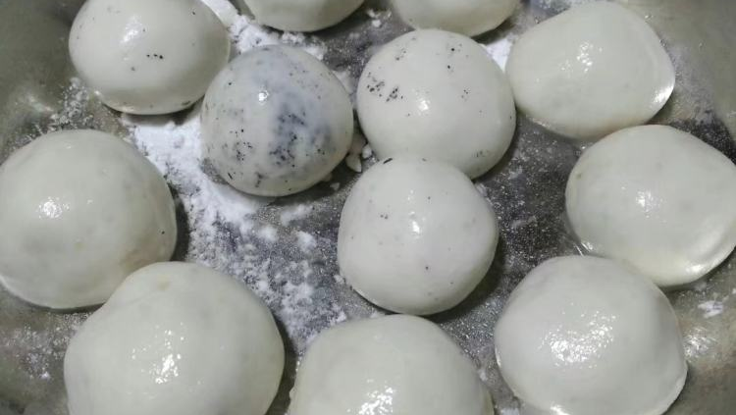
汤（tāng） 圆（yuán）
Notes:
And then, we get Tang Yuan

Slide 21
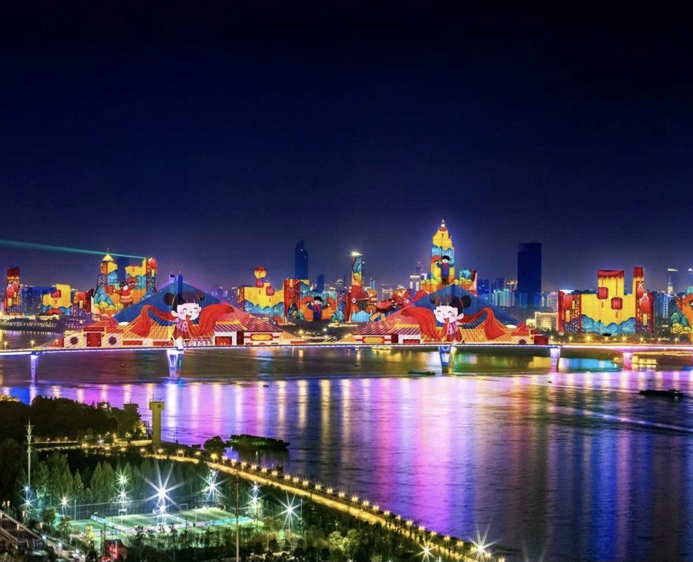
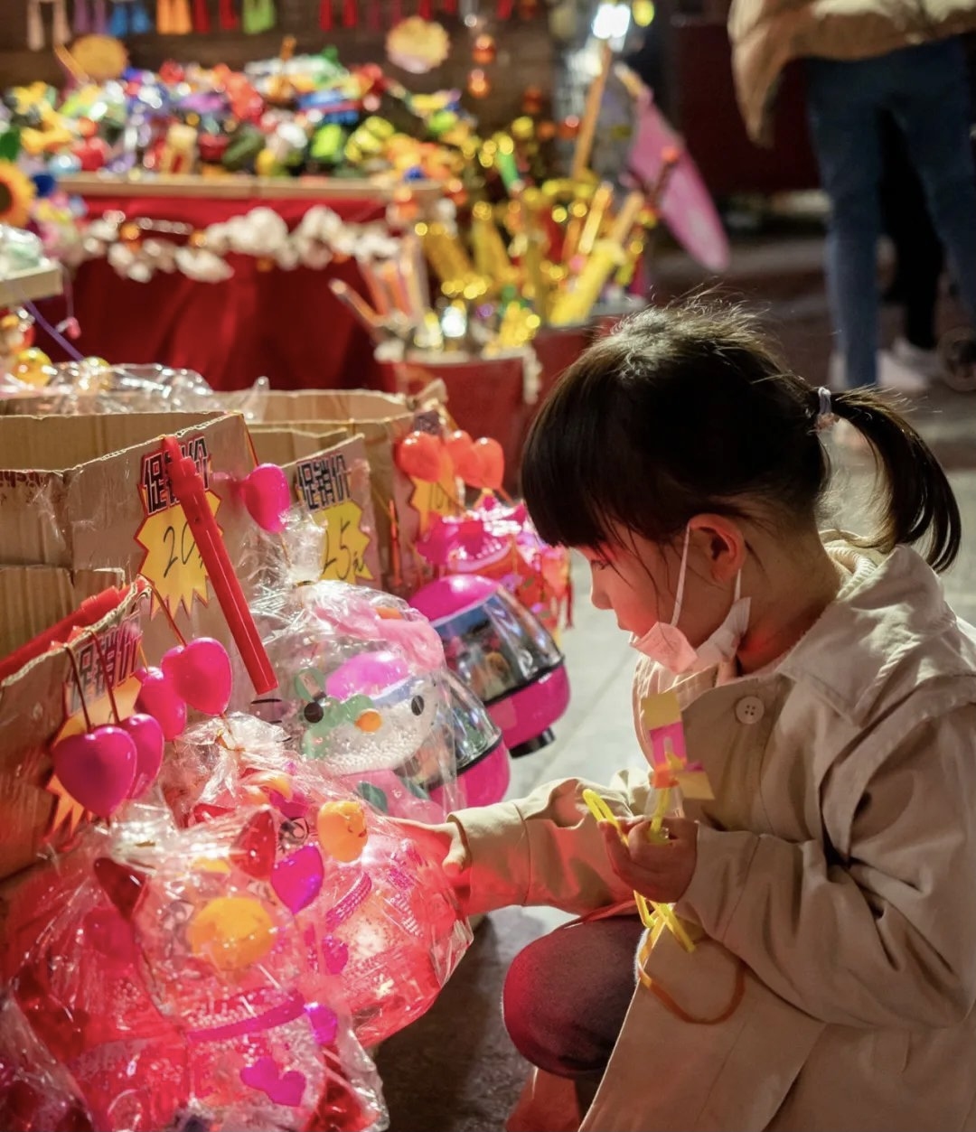
We will reunite soon.
Tonight @ Wuhan
Notes:
Last year at this time, Chinese people were ordered to stay at home and they cannot reunite on Spring and Lantern festivals. But today, this girl is able to choose and buy her favourite lantern in a street market in Wuhan.
I believe that in the near future, we can also see each other in person in Edinburgh and be back to our normal life.
Wish all of use a safe and happy new year!

